Slide 1

Docker
Lecture-1
www.corvit.com

Slide 2
Topics
SDLC
Source Code Deployment Phases
Software Applications
Web Applications Execution Components
Software Delivery Cycle
Container Concept
Advantages of using Containers
Containerization Architecture
Docker
Docker Terms
How Docker Works
Creating account on Docker Hub
Docker Client Installation
www.corvit.com

Slide 3
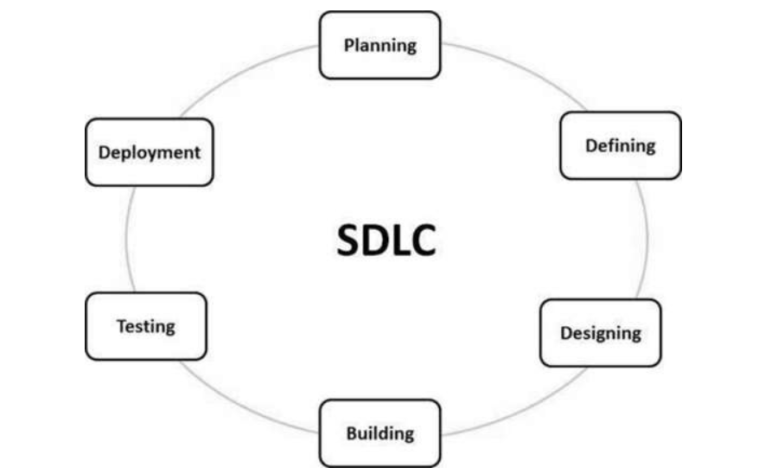
www.corvit.com

Slide 4
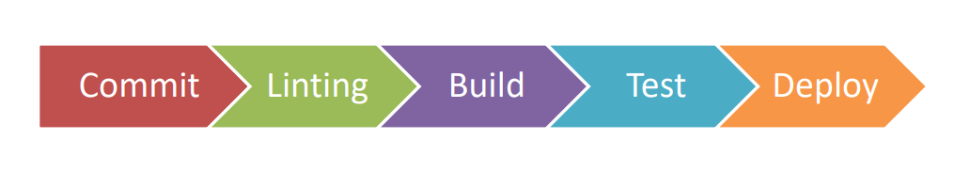
Source Code Deployment Phases
www.corvit.com

Slide 5
Software Applications
Web Sites
Web Applications
Desktop Applications
Mobile Applications
APIs (Application Programming Interface)
www.corvit.com

Slide 6
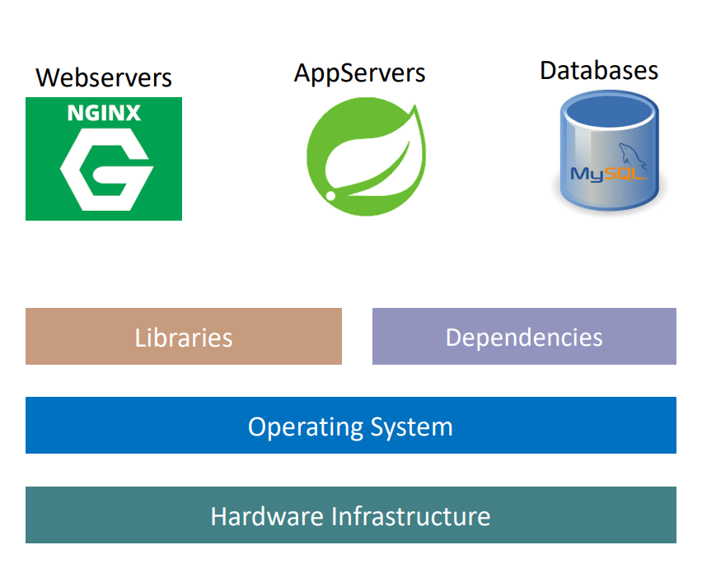
Web Applications Execution Components
www.corvit.com

Slide 7
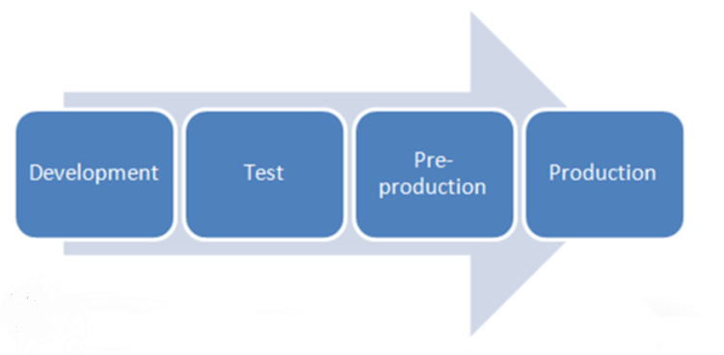
Software Delivery Cycle
www.corvit.com

Slide 8
What problems we have with Traditional Infra?
Installation & Configuration
Time consuming
Need to perform install/configs on every server and every environment (dev, qa, staging, production)
Compatibility & Dependency
Need to keep resolving issues related to libraries and dependencies
Inconsistencies across Environments
Very hard to track changes across Dev/QA/Staging and Prod environments and they end up with inconsistencies
Operational Support
Need more resources to handle operational issues on day to day basis
• Server Support (hardware, software)
• Patching releases
Developer Environments
When a new developer joins the team, time it takes to provision his development environment in traditional approach is time taking.
www.corvit.com

Slide 9
Container Concept
Lets say you create an application and that is working fine on your machine.
But in production it doesn’t work fine; developers experience it a lot.
That is when the famous Developer’s words are spoken. “It is not working, but its working on my machine, we cannot handover your machine to the client”.
The reason could be due to dependencies, libraries and versions, framework, OS level features and microservices that the developers machine have but not there in the production environment.
We need a standardized way to package the application with its dependencies and deploy it on any environment.
Docker is a tool designed to make it easier to create, deploy and run applications by using containers.
Docker packages an application and all its dependencies in a virtual container that can run on any server.
Each container runs and isolated process in the user space and take up less space than regular VMs due to their layered architecture.
So it will always work the same regardless of its environment
www.corvit.com

Slide 10
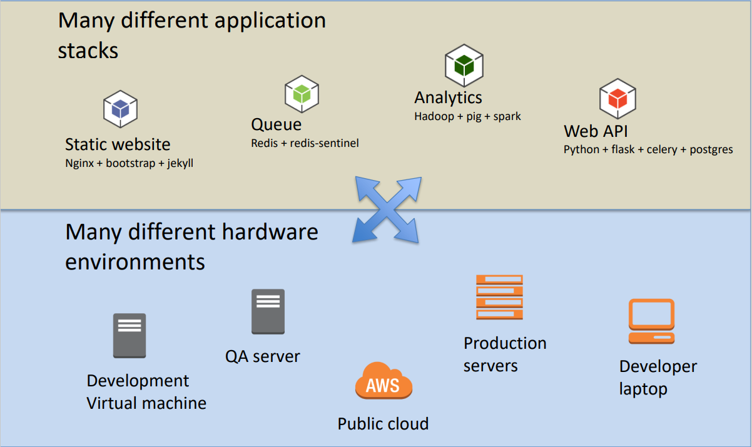
Fragile IT
www.corvit.com

Slide 11
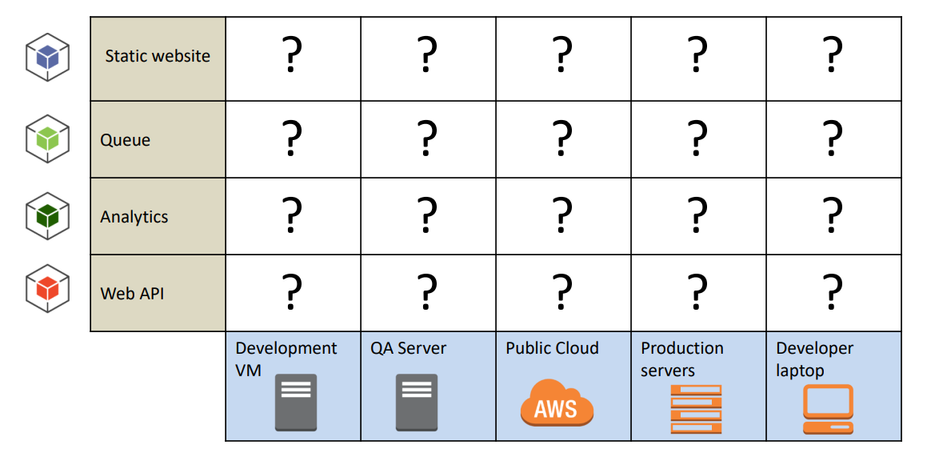
Fragile IT
www.corvit.com

Slide 12
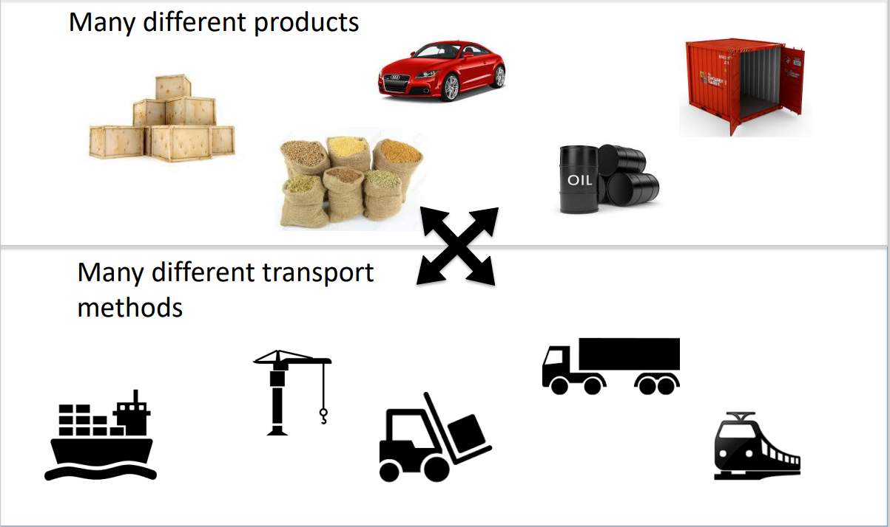
Transporting Cargo Pre-1960
www.corvit.com

Slide 13
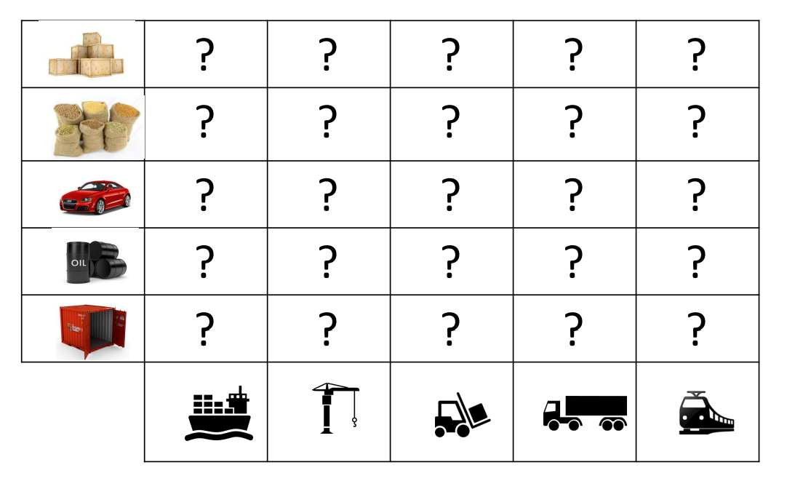
Cargo Transport Matrix
www.corvit.com

Slide 14
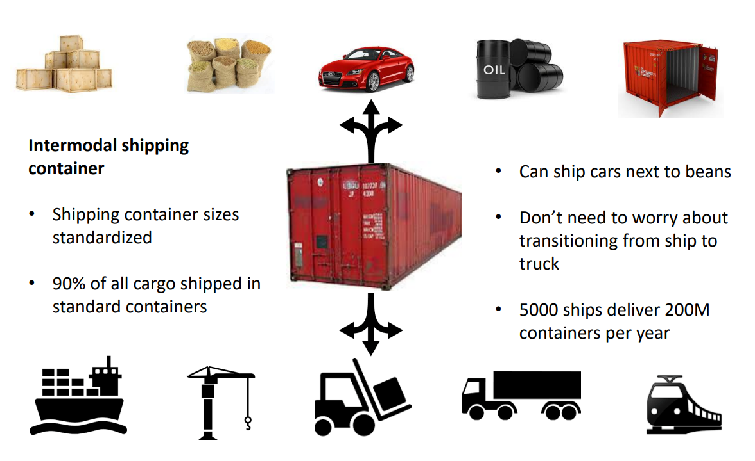
Intermodal Transport Solution
www.corvit.com

Slide 15
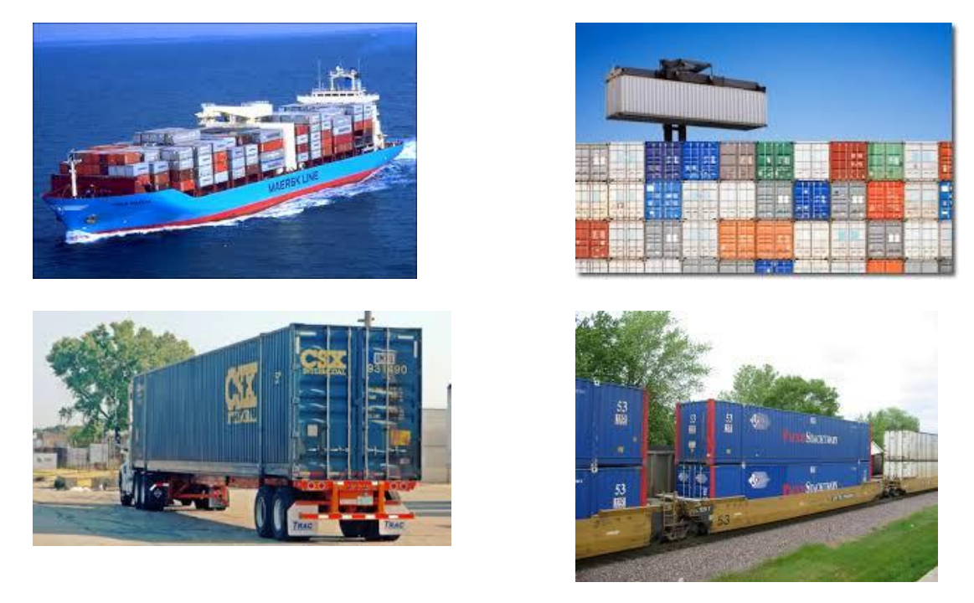
Intermodal Shipping Containers
www.corvit.com

Slide 16
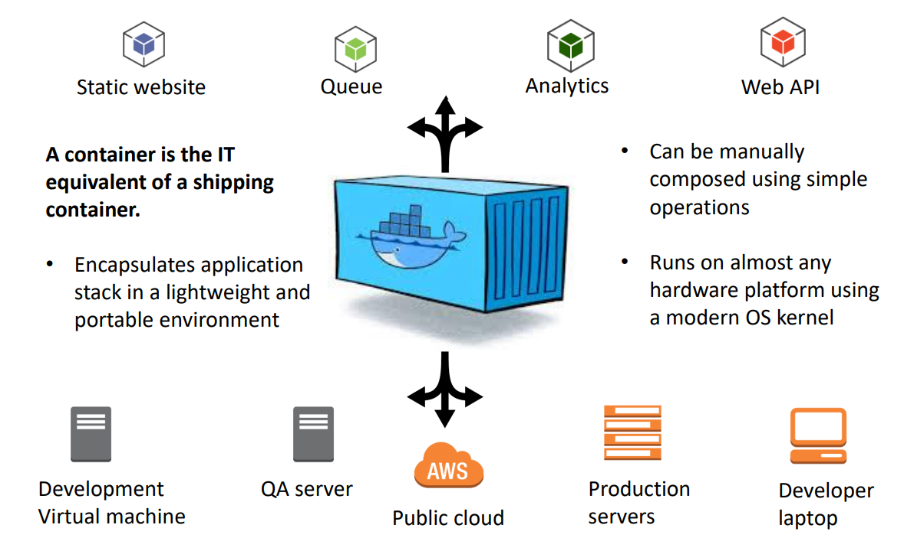
IT Transport Solution: Containers
www.corvit.com

Slide 17
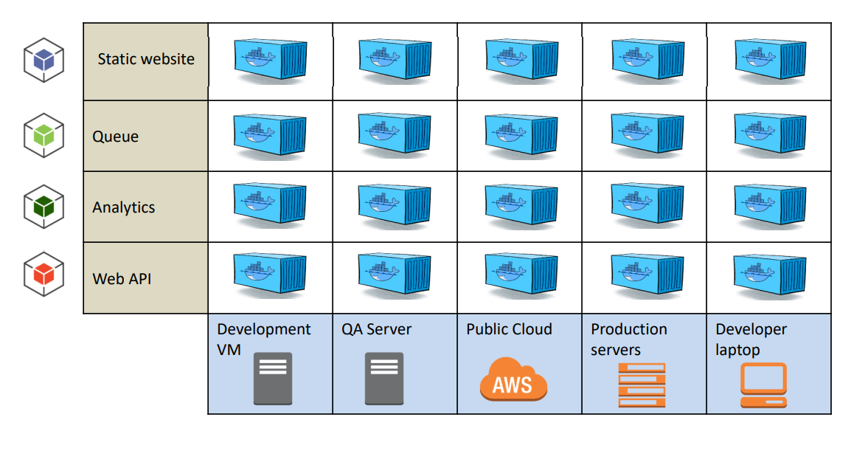
IT Matrix Solution
www.corvit.com

Slide 18
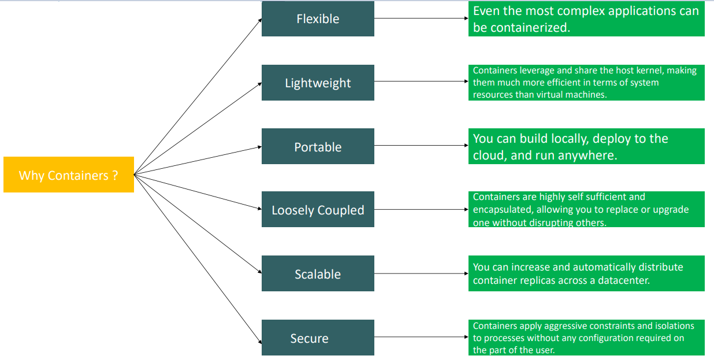
Advantages Of Using Containers
www.corvit.com

Slide 19
Developer Benefits
Build the application stack once and run it anywhere.
Eliminate concerns about compatibility on different hardware platforms. • The application will run in dev, testing, and at the customer site.
No worries about missing application dependencies like required packages.
Each application runs in its own container to eliminate conflicts like different shared libraries.
Easy to automate application testing and deployments using scripting.
Much less performance penalty than virtual machines.
www.corvit.com

Slide 20
IT Operations Benefits
Configure the application once, run it anywhere.
Application lifecycle (develop/test/deploy) becomes much more repeatable
Eliminate inconsistencies between development, testing, and production environments
Simplifies continuous integration/deployment practices
Addresses performance and financial costs associated with virtual machines
www.corvit.com

Slide 21
Containerization Architecture
www.corvit.com

Slide 22
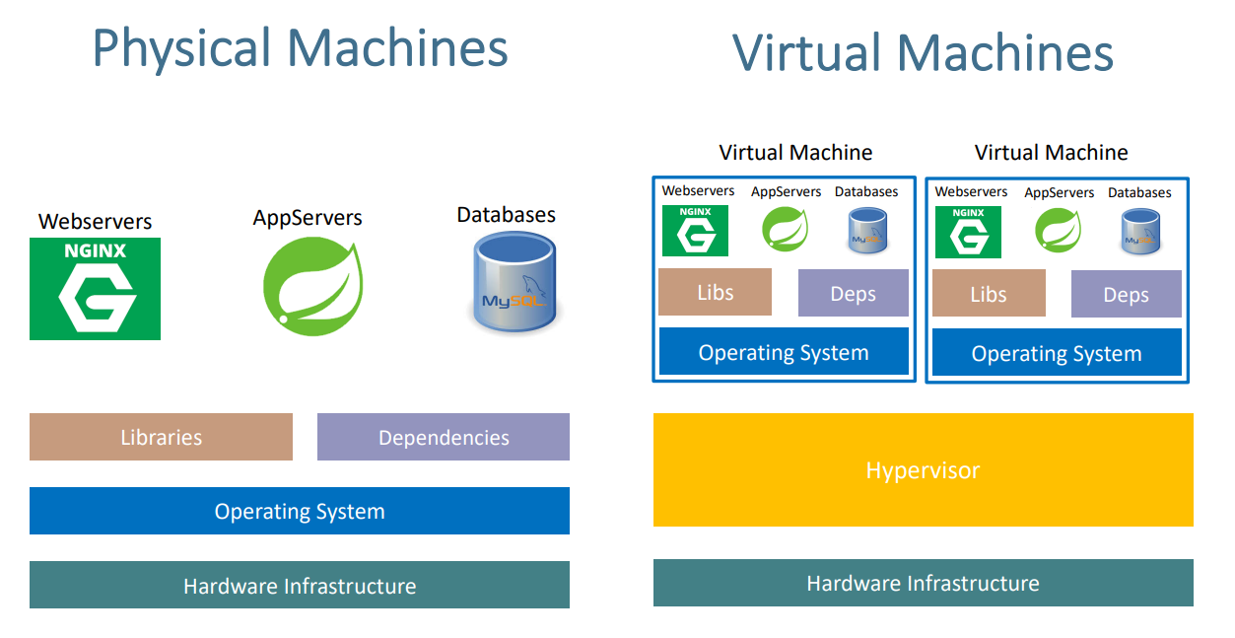
www.corvit.com

Slide 23
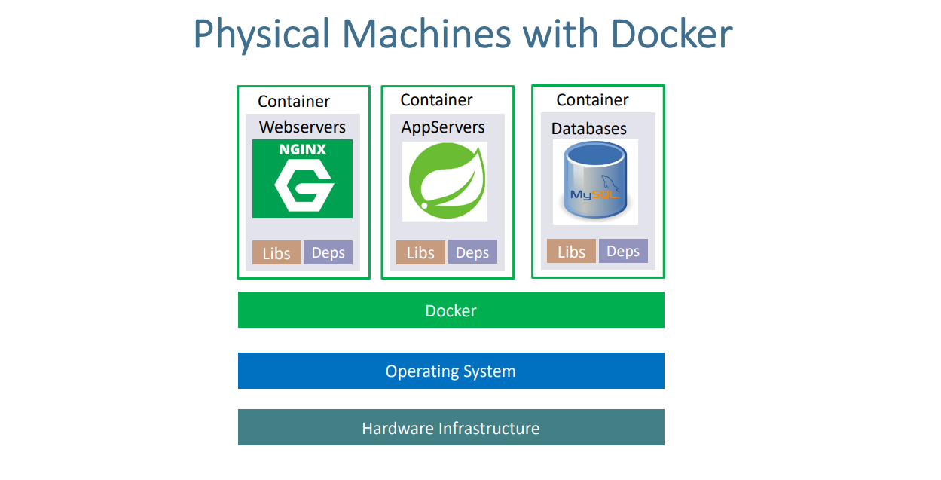
www.corvit.com

Slide 24
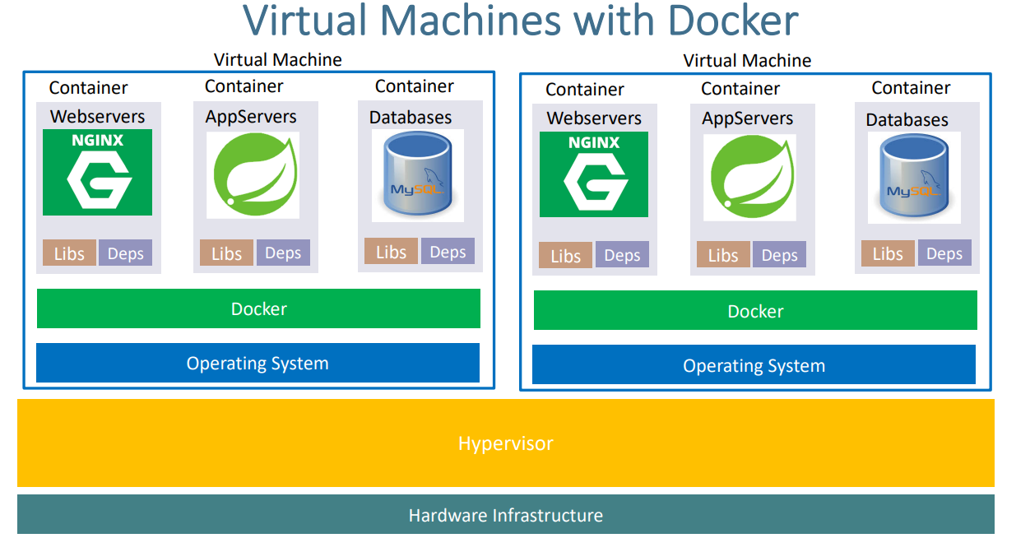
www.corvit.com

Slide 25
High Level Overview
A container feels like a lightweight VM.
– You can log into it and get a shell.
– It has its own process space.
– You can run commands within the container as root.
– You can install packages in the container.
– The container can run services.
– You can modify network settings in the container.
www.corvit.com

Slide 26
Low Level Overview
But… it’s not quite like a virtual machine.
– It uses the host kernel.
– It can’t run a different OS than the host.
– It can’t load its own kernel modules.
– It can’t emulate devices like usb, storage, etc.
– Network using port forwarding
– It doesn’t need to run OS-type processes like syslogd and cron.
www.corvit.com

Slide 27
Container advantages over VMs
What can a container do that a VM cannot?
– Really simple app deployment with a single command line.
– “Boot” in a fraction of a second compared to a minute for a VM.
– Enables very granular services (micro-service architecture).
– Significantly reduce testing and development footprint.
• Imagine the resource savings when launching hundreds of containers vs VMs.
www.corvit.com

Slide 28
Docker
An open-source Linux-based container implementation started by Solomon Hykes in France.
Initially released in 2013 and now in widespread use by cloud providers and enterprises.
It’s really an API and toolset that utilizes existing Linux facilities like cgroups and namespaces.
Docker wasn’t the first Linux-based container solution
– Google developed cgroups 10 years earlier.
– OpenVZ
– Virtuozzo
www.corvit.com

Slide 29
Traditional vs. Docker Application Deployment
Traditional
Container
– Ship packages via rpm, gem, jar, etc.
– Deal with dependency conflicts.
– “Works on my machine.
– Ship containers with all dependencies.
– Break application stack into layers and only ship layers that change.
– “Works on any machine.”
www.corvit.com

Slide 30
Docker Terms
Docker Daemon
The Docker daemon (dockerd) listens for Docker API requests and manages Docker objects such as images, containers, networks, and volumes.
Docker Client
Docker client can be present on either Docker Host or any other machine.
The Docker client (docker) is the primary way that many Docker users interact with Docker.
When you use commands such as docker run, the client sends these commands to dockerd (Docker Daemon), which carries them out.
The docker command uses the Docker API.
The Docker client can communicate with more than one daemon.
Docker Images
An image is a read-only template with instructions for creating a Docker container.
Often, an image is based on another image, with some additional customization.
For example, we may build an image which is based on the ubuntu image, but installs the Apache web server and our application, as well as the configuration details needed to make our application run.
www.corvit.com

Slide 31
Docker Terms
Docker Containers
A container is a runnable instance of an image.
We can create, start, stop, move, or delete a container using the Docker API or CLI.
We can connect a container to one or more networks, attach storage to it, or even create a new image based on its current state.
When a container is removed, any changes to its state that are not stored in persistent storage disappear.
Docker Registry or Docker Hub
A Docker registry stores Docker images.
Docker Hub is a public registry that anyone can use, and Docker is configured to look for images on Docker Hub by default.
We can even run our own private registry.
When we use the docker pull or docker run commands, the required images are pulled from our configured registry.
When we use the docker push command, our image is pushed to our configured registry.
Host
A machine running containers.
www.corvit.com

Slide 32
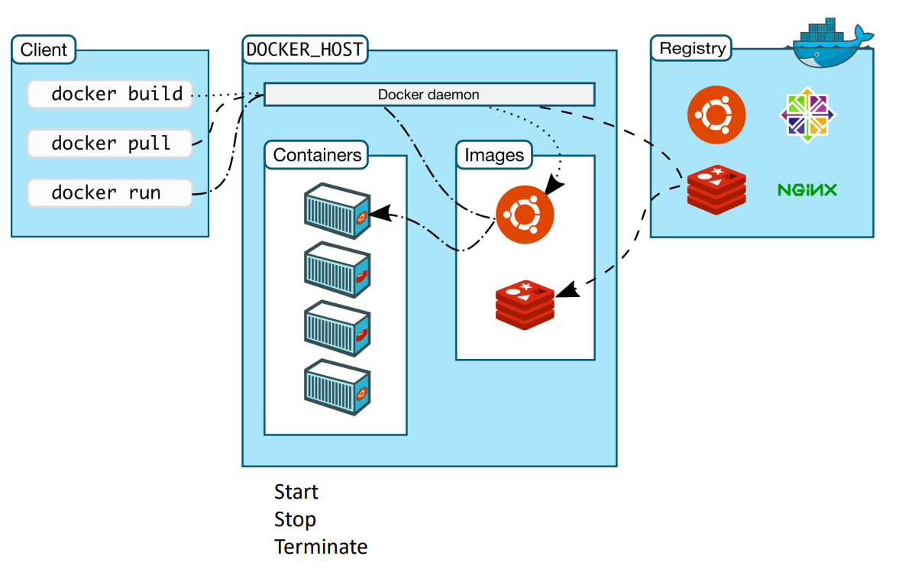
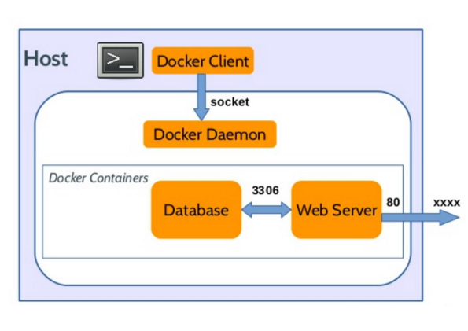
How Docker Works
www.corvit.com

Slide 33
Docker Client Installation
https://docs.docker.com/desktop/install/windows-install/
www.corvit.com

